Slide 1

Data Transformation III

Slide 2
Data Transformation III Info
Finish Reading Chapter 3 and Practice the Code in R4DS
Covers
The Pipe
Statistical Summaries
Grouped Summaries
Helpful Functions
Builds Off Tutorial 3

Slide 3
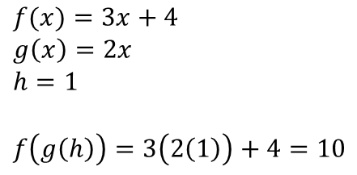
The Pipe
Useful for Combining Multiple Steps of Operations
Represented by %>%
Reads as “Then”
Works Like a Composite Function From Algebra
$$f(x)=3x+4$$
$$g\left(x\right)=2x$$
$$h=1$$
$$f\left(g\left(h\right)\right)=3\left(2\left(1\right)\right)+4=10$$
OUT = h %>%
g() %>%
f()
OUT = 10

Slide 4
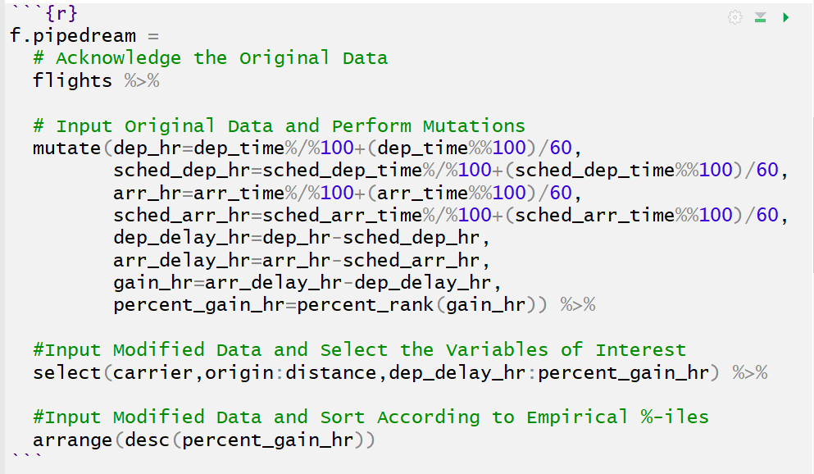
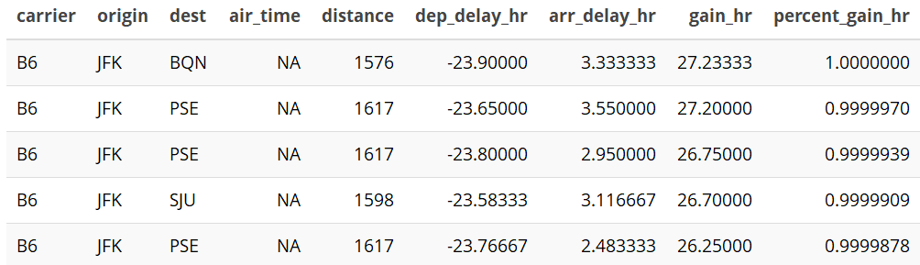
The Pipe
Chaining with the Pipe
HTML Table: knitr and kableExtra

Slide 5
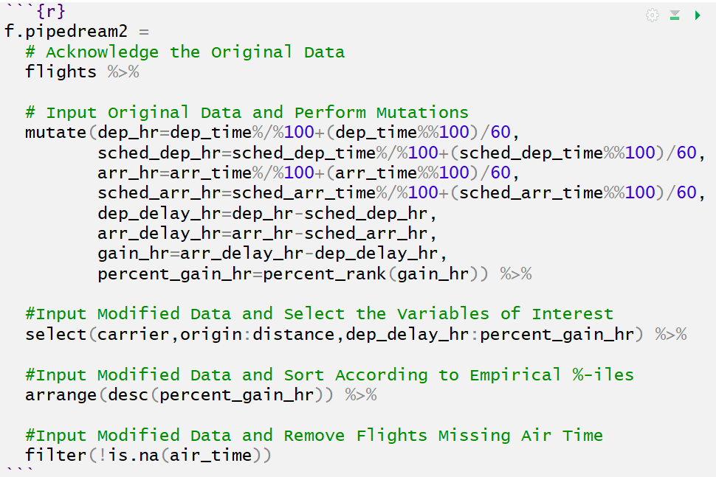
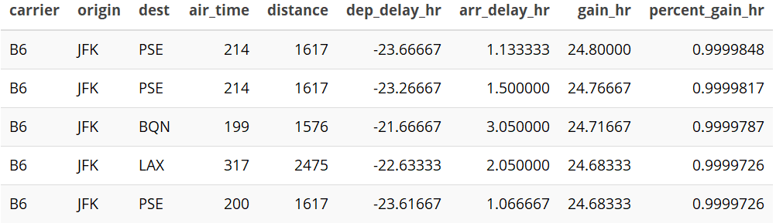
The Pipe
Chaining with the Pipe

Slide 6
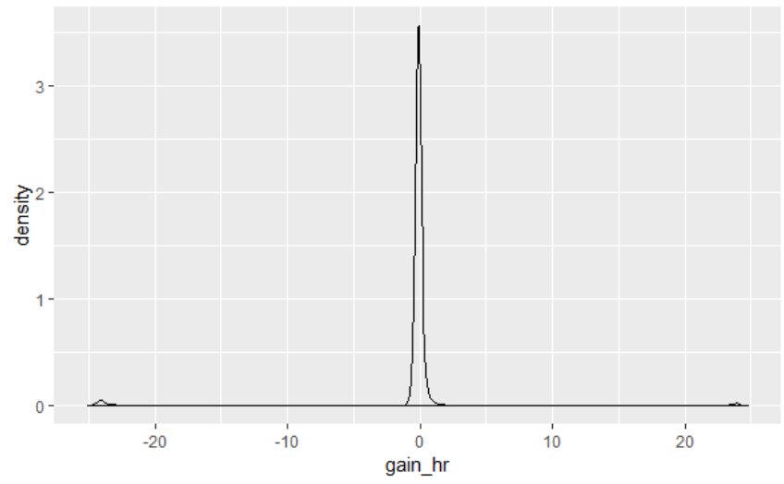
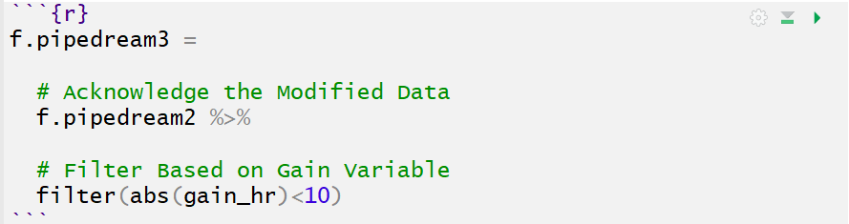
The Pipe
Chaining with the Pipe
Outliers

Slide 7
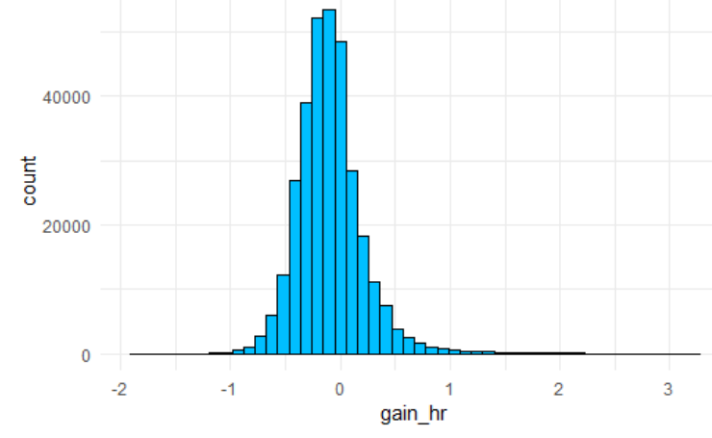
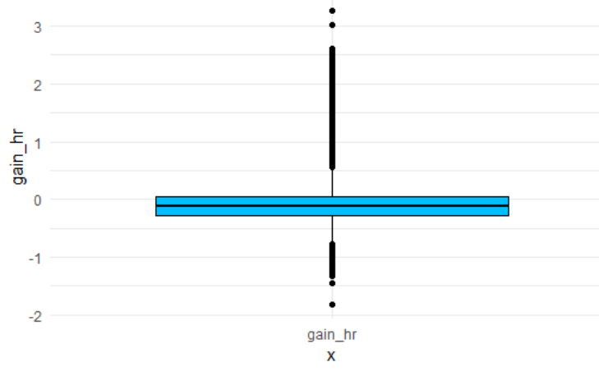
summarize()
Summarizing All Data
Using Graphics
Both the histogram and the boxplot are made from summary statistics.
(Statistical Transformations in Ch. 3)

Slide 8
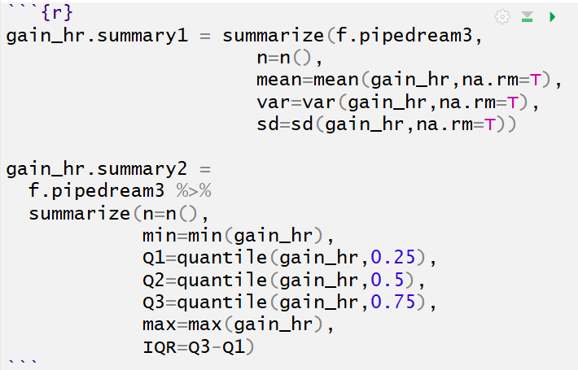

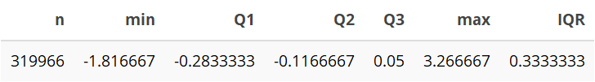
summarize()
Summarizing All Data
Using Tables

Slide 9
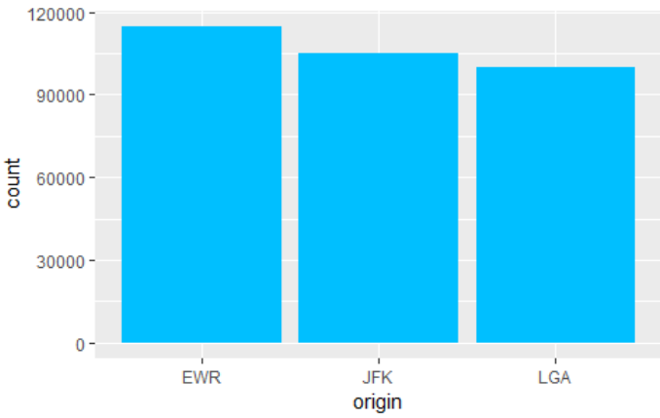
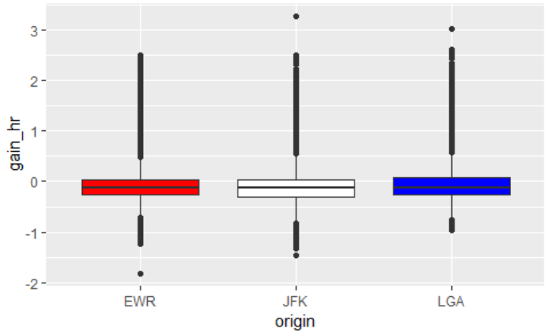
summarize() with group_by()
Summarizing Data by Groups
Using Graphics

Slide 10
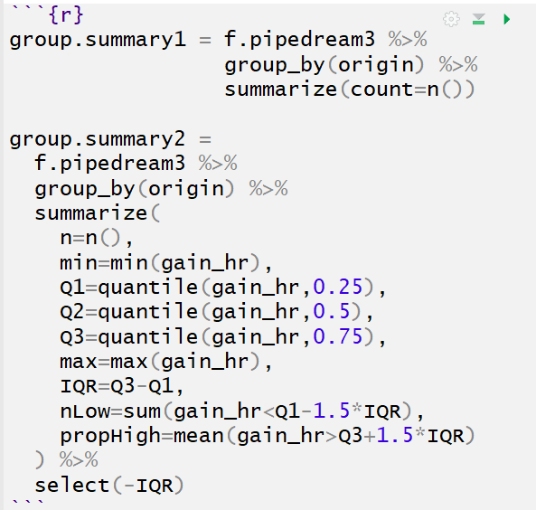
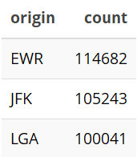
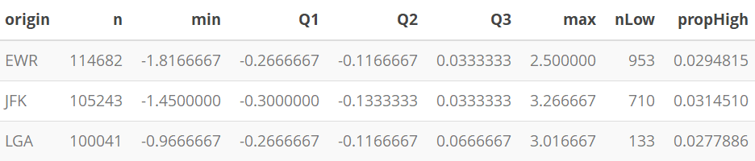
summarize() with group_by()
Summarizing Data by Groups
Using Tables

Slide 11
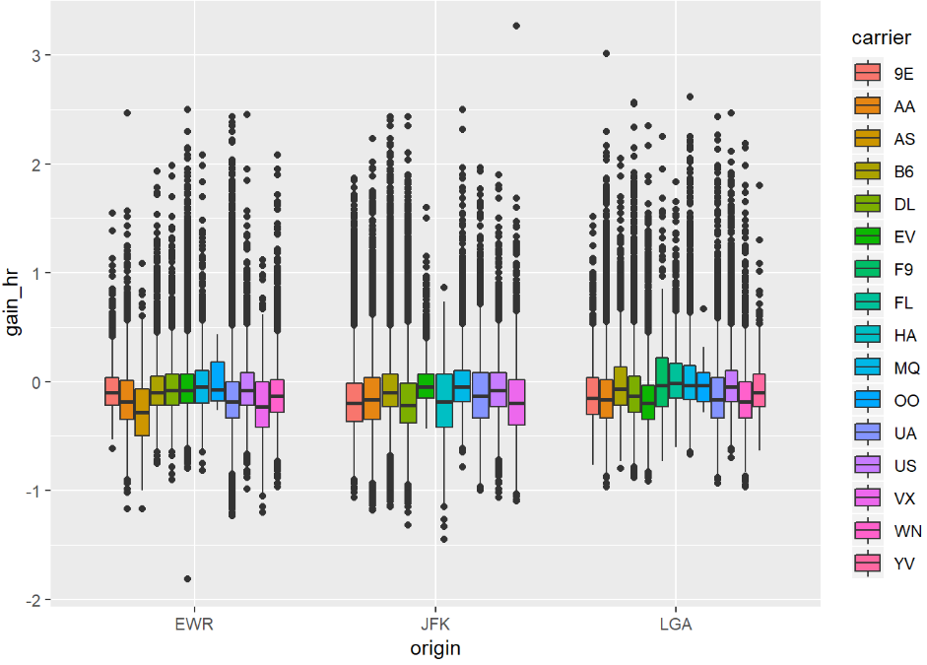
summarize() with group_by()
Multiple Groups
Using Graphics

Slide 12
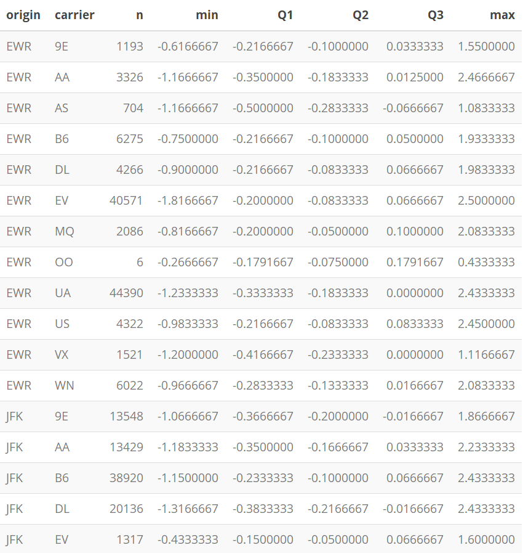
summarize() with group_by()
Multiple Groups
Using Tables

Slide 13
Useful Summary Functions
Measures of Center
mean()
median()
mode()
Measures of Spread
var()
sd()
IQR()
mad()
Measures of Rank
min()
max()
quantile()

Slide 14
Useful Summary Functions
Measures of Position
Order Matters
first() = x[1]
last() = x[length(x)]
nth(,k) = x[k]
Counts
n()
n_distinct()
Counts/Proportions for Logical
sum()
mean()
Example
sum(x>10)
mean(x>10)

Slide 15
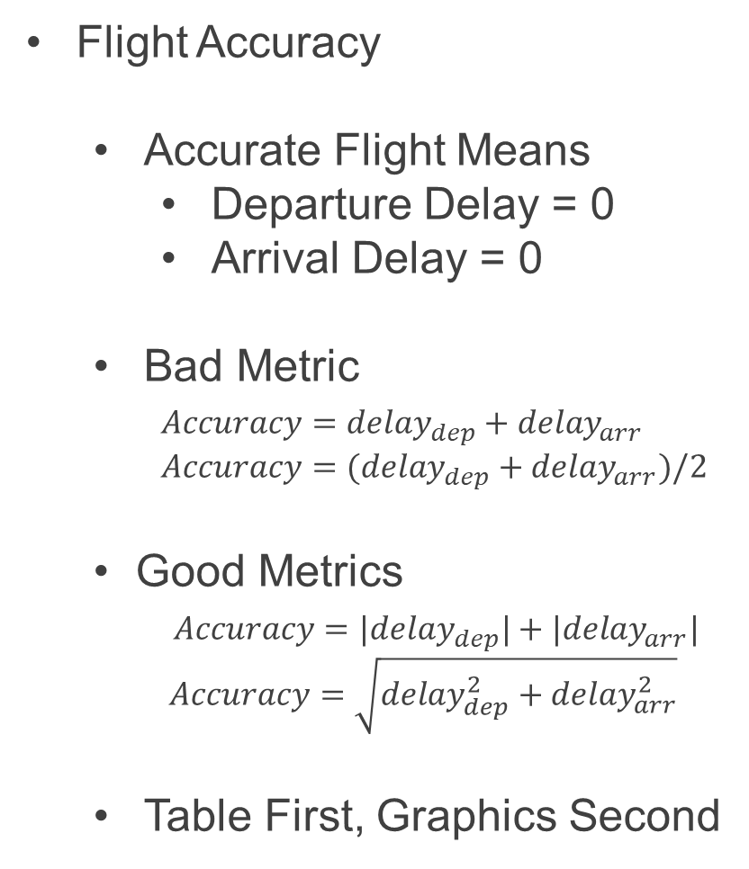
Case Study
Flight Accuracy
Accurate Flight Means
Departure Delay = 0
Arrival Delay = 0
Bad Metric
$Accuracy=delay_{dep}+delay_{arr}$
$Accuracy=(delay_{dep}+delay_{arr})/2$
Good Metrics
$Accuracy=|delay_{dep}|+|delay_{arr}|$
$Accuracy=\sqrt{delay_{dep}^{2}+delay_{arr}^{2}}$
Table First, Graphics Second

Slide 16
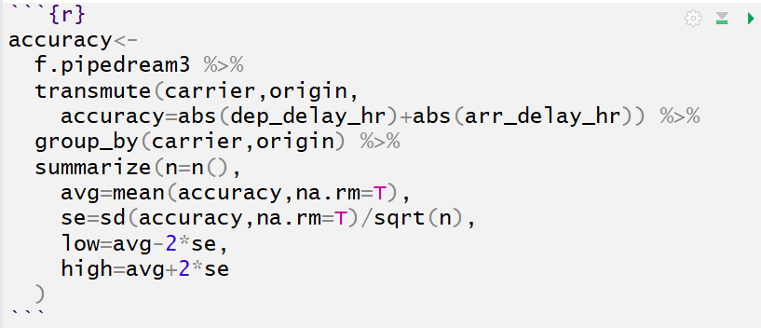
Case Study
Summary Table
Step 1: Accuracy Variable
Step 2: Grouping
Step 3: Summarize Info
Mean
Standard Error
Lower Bound (95% CI)
Upper Bound (95% CI)

Slide 17
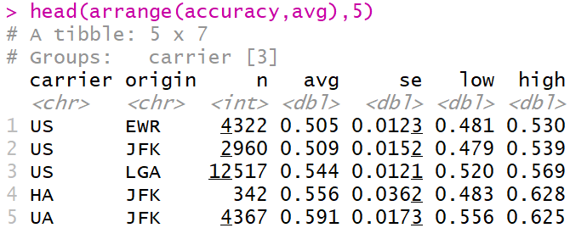
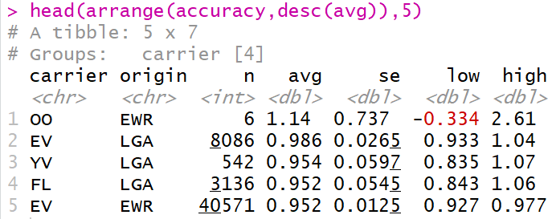
Case Study
Sorted by Average Accuracy
Best Carriers/Origin
Worst Carriers/Origin

Slide 18
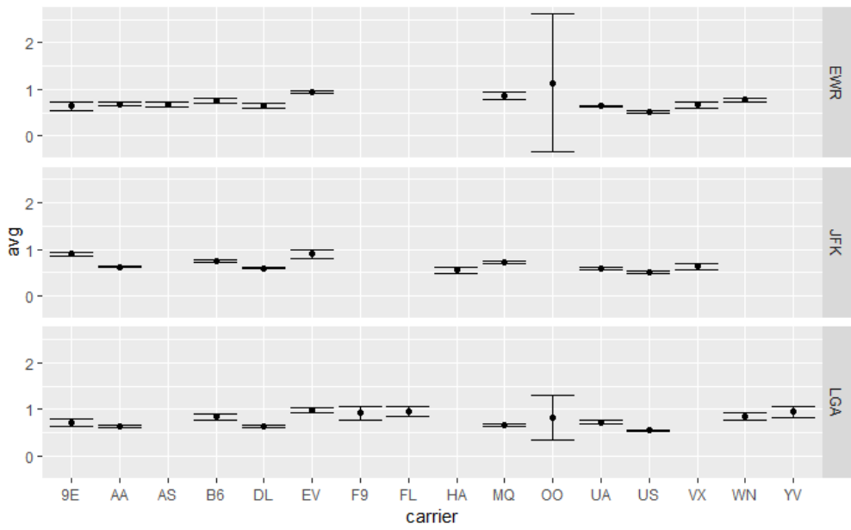
Case Study
95% Confidence Intervals
Carrier “OO” Creates a Visual Problem Due to Small Sample Size

Slide 19
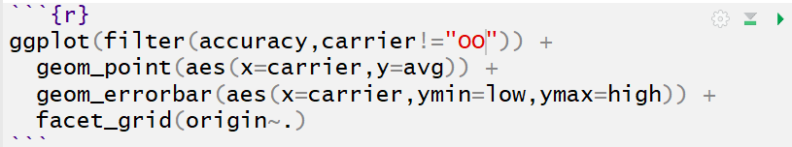
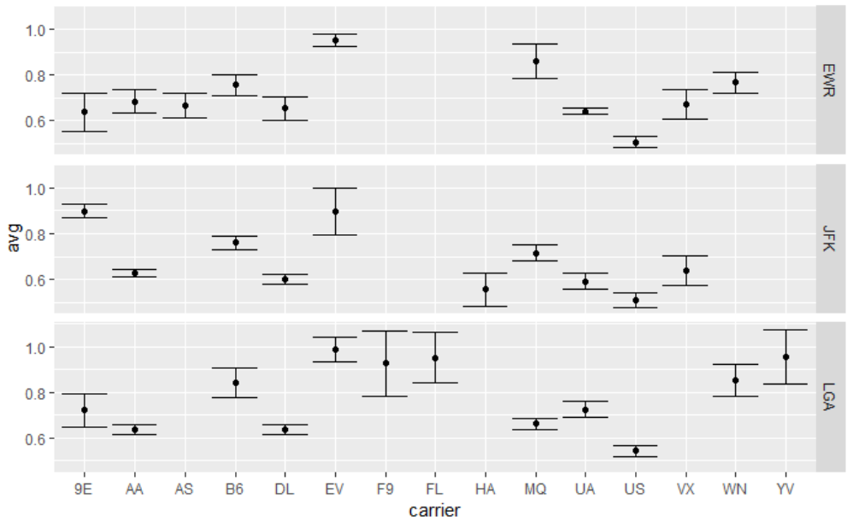
Case Study
95% Confidence Intervals

Slide 20
Closing?
Disperse and Make Reasonable Decisions

